Slide 1
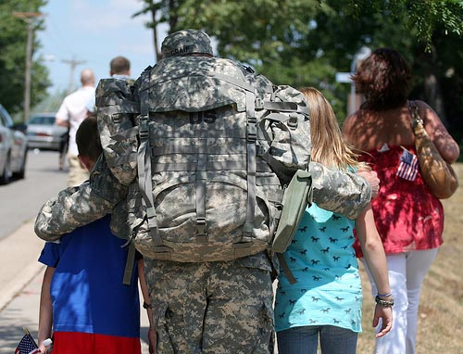
Let’s Talk…… about Military Families
M Military Connection Point of Contact (POC):
LTC Memminger/Mr. J. Howard – DBHS
Mr. Ms. Zakira Rich - CCS
Student 2 Student POC – LTC Memminger/
Ms. J. Ramirez
_
Notes:
Good Afternoon. Today we want to take about 10 minutes to share some information regarding The Purple Star program and it’s emphasis on the military and military families. The Military Family and Youth Liaison for the county is Ms. Zakirah Rich. The POC for DBHS is myself and LTC Memminger. We also have a third leg of this operation called the Military Child Education Coalition/Student 2 Student POC and that person is Ms. J. Ramirez who is also one of our Science teachers. I also want to let you know while I am at slide number 1, that your exit ticket for today’s professional development will be to simply type one idea that we could do school-wide to recognize our military connected students; so please provide that by the time we leave today’s meeting.

Slide 2
Agenda
Role
Military Impact
Challenges
Our Responsibility
Resources
Questions
Notes:
This is our agenda for today’s PD …

Slide 3
Military Connection POC
Role
To bring awareness of military-connected students
To serve as the link among the school, military families, community, and district’s liaison
Help implement programs and practices to support military-connected students and families
Notes:
These are the basic roles of the Military Connection POC at the school level. The state of NC has many programs
set up to service military students and their families. One of those programs is the Purple Star program. Some
of you may not know that Cumberland County Schools (CCS) serves the third largest concentration of
military-connected students in the world. Some of you may be wondering why so much emphasis is placed
on the military and military families in North Carolina. The CCS and the local military installations of Ft. Bragg
and Pope Air Field, as well the North Carolina National Guard and Reserve components have enjoyed a strong
history of positive relationships built on service and collaboration.

Slide 4
Military Impact (*Largest Culture*)
CCS Enrollment = Over 51,000 students
CCS Military Connected-Students = Over 15,100 (29.6%)
Douglas Byrd High School = _123 out of 988__ ( 12.4%)
Major Military Installations
Ft. Bragg & Pope AAF
Assigned Schools for Students From Ft. Bragg
E.E. Smith & W.T. Brown
Notes:
As I mentioned earlier Cumberland County Schools has the 3rd largest concentration of military Students and families in the world.
Please see the slide above for other stats concerning the volume of students we accommodate with the Purple Star program.
(1) Total Student Enrollment: ____901______ (2) Total Number of Students who are Military Family Connected: ______145_____
(% of Students who are military connected: ___16_______)

Slide 5
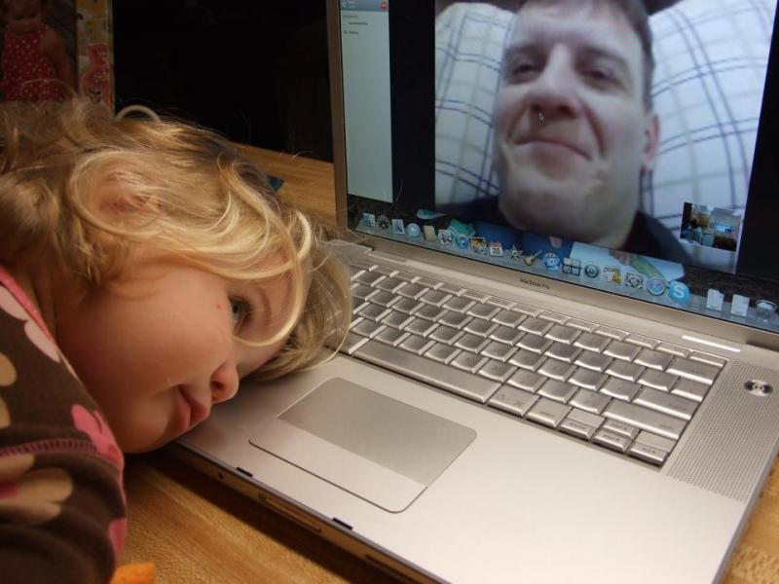
Challenges
Deployments
Loss/Grief
Transition (Schools, Friends, TDY)
Increased stress level for families
Wounded Warriors (Physical, TBI, PTSD)
Distance from military community limits access to resources
Separation from military service (ETS, Medical, Retirement)
Notes:
These are many of the challenges that our military families face on a daily basis and subsequently Our students deal with the second and third order of effects of these challenges.

Slide 6
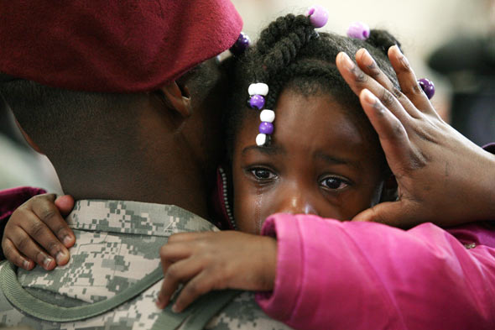
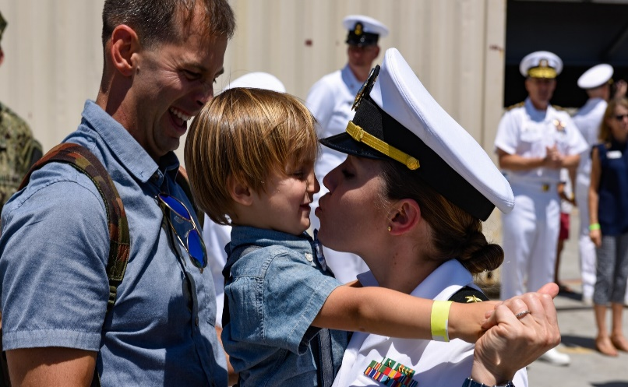
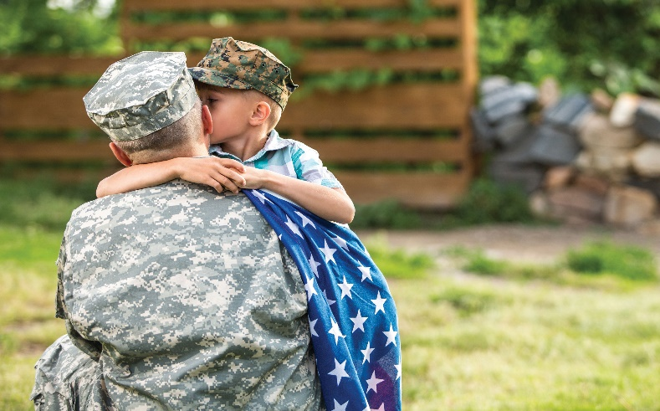
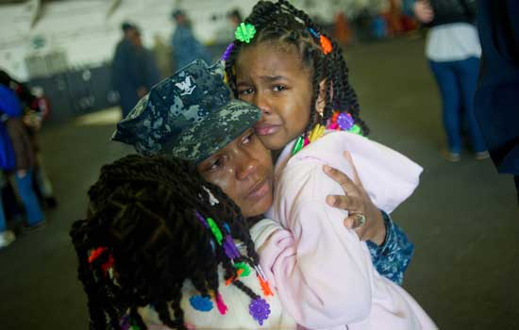
Challenges
http://www.youtube.com/watch?v=KDFXxgz0vHc
Notes:
Please watch the short video attached that features young students
Demonstrating resilience and dealing with an active deployment of their parents to
Afghanistan. There has been ongoing conflict in this region going on 19 years.
http://www.youtube.com/watch?v=KDFXxgz0vHc

Slide 7
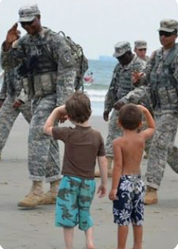
Our Responsibility …
Adaptable
Resilient
Global Knowledge
Flexible
Adventurous
Diversity
Tolerance & Respect
Value on Education
Team Players
Notes:
So, here is the message we want you to take back to your departments: Going forward, when you hear an announcement about us recognizing and acknowledging military connected students and their families, please participate. Whenever you see an opportunity to provide social emotional learning support to your military students make sure you keep artifacts of that effort and inform LTC Memminger or myself of your efforts and the outcomes. It could be something as simple as wearing purple to commemorate our military students Or taking 5 minutes to conduct a check-in of your military students or to discuss current events that directly affect your military students. Whenever we conduct or sponsor these type of activities, we are fulfilling the descriptors
outlined in the Purple Star initiative so that we can once again be recognized as a Purple Star School for another year.

Slide 8
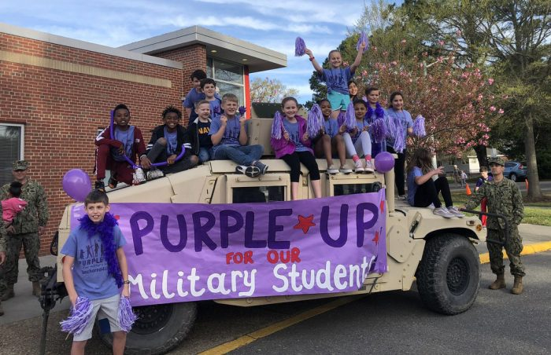
Support Military Connected Students CCS Purple Up Day
April 19, 2024

Slide 9
Web Resources
www.militarychild.org
www.militarykidsconnect.org
www.sesamestreetformilitaryfamilies.org
www.mic3.net
www.tutor.com
www.nctsn.org
http://mil.ccs.k12.nc.us/
Notes:
These internet resources are intended to inform educators of some of the different service and community programs available to assist our military connected families.
The last link is the county’s own web site that caters to military connected students and families.
( HIGHLIGHT 2 OR 3 OF THE WEBSITES)
The link before that is The National Child Traumatic Stress Network link; it’s mission is to raise the standard of care and improve access to services for traumatized children, their families and communities throughout the United States. Tutor .com is a website that provide tutoring in all subject areas including the SAT for military connected students. The Military Interstate Children’s Compact Commission website; The Council of State Governments (CSG), in cooperation with the US Department of Defense, drafted this Interstate Compact to address some of the educational challenges transitioning children of military families face. Since July 2006, CSG worked with a variety of federal, state and local officials as well as national stakeholder organizations representing education groups and military families to create the new interstate agreement.
While the Compact is not exhaustive in its coverage, it does address the key issues encountered by military families: eligibility, enrollment, placement and graduation. In addition, the Compact provides for a detailed governance structure at both the state and national levels with built-in enforcement and compliance mechanisms.
The goal of the Compact is to replace the widely varying policies affecting transitioning military students. The Compact leverages consistency: It uses a comprehensive approach that provides a consistent policy in every school district and in every state that chooses to join.
The Compact addresses key educational transition issues encountered by military families including enrollment, placement, attendance, eligibility and graduation.
Children of active duty members of the uniformed services, National Guard and Reserve on active duty orders, commissioned officers of the National Oceanic and Atmospheric Administration (NOAA) and the Unites States Public Health Service (USPHS), and members or veterans who are medically discharged or retired for one year are eligible for assistance under the Compact. The Compact also covers students of members who perish on active duty for a period of one year following their death.
THE MILITARY CHILD EDUCATION COALITION: Who Are We?
The Military Child Education
Coalition is a 501 (c)(3)
nonprofit organization that
solely exists to help the
military child thrive in the face
of transition and separation.
Our Mission
MCEC is dedicated to
ensuring inclusive, quality
educational experiences for all
military-connected children
affected by mobility, family
separation, and transition.
Our Community
MCEC is a professional
Coalition with a diverse
community consisting of public
school districts, private schools,
colleges and universities, small
businesses and corporations,
nonprofit organizations,
military commands and
installations, military families,
and caring individuals from local
communities across our Nation.

Slide 10
Purple Star Award
Notes:
Last School Year, DBHS was awarded the Purple Star designation and the Banner is displayed in the school.

Slide 11
Questions
https://www.youtube.com/watch?v=yHgzc6dh8cs&t=4s

Slide 12
Questions
https://www.youtube.com/watch?v=yHgzc6dh8cs&t=4s

Slide 13
Back Up Slides
Where Should You Be?
School Activities That Should be Complete:
● Point of Contact/Designee: (Your School’s POC)
● Designated Central Office Staff Member: (Mr. Lattimore)
● Awareness and knowledge of the Military Interstate Children’s Compact Commission (MIC3): (On example application I Sent You)
● Optional School Activities: (At least one of two activities complete)
● Professional Development: (Should be complete by December 17, 2020)
https://www.youtube.com/watch?v=yHgzc6dh8cs&t=4s

Slide 14
Back Up Slides (cont.)
School Activities That Should be a Working Progress:
● Resource Website: (Complete on or Before January 20, 2021)
● Transitions Program: (Complete on, or before January 20, 2021)
● Optional School Activities: (Both complete on, or before January 20, 2021)
Note: You may use flyers, agendas, or announcements as artifacts for fall events. Purple up for CCS is 4/16
https://www.youtube.com/watch?v=yHgzc6dh8cs&t=4s

Slide 15
Support Military Connected Students
April 16, 2021
https://www.youtube.com/watch?v=yHgzc6dh8cs&t=4s
Notes:
This is just one of the initiatives coming up in April of next year where everyone is asked to wear purple in recognition of the military community and the demands placed on those families as members of the Armed Services.

